Slide 1


AWS STEP FUNCTIONS Serverless Workflow Orchestration (Part 2)
By
Neerad Shakya
Developer, PACES Team
Notes:
11

Slide 2
Contents
Part 1-Review
Containerized Task Executors
Task Token Executor
Infrastructure as Code
Question and Answers

Slide 3
1. PART 1-REVIEW

Slide 4
What did we cover?
What is Step Function and what are its capabilities?
Amazon State Languages.
State language fields (Mandatory and Optional)
Types of States and their functions
Transition
Data Flow
Paths
Example: Basic Step Function with Lambda
Use of console
Use of VS code extension
Example: Choice State
Example: Data Flow, Choice, Path
Notes:
The Output of one step is the Input for the Next step

Slide 5
2. Containerized Task Executors
.NetCore 3.1
VS Code/ ASL
Docker
ECS Fargate Task
Lambda Function
Step Function

Slide 6
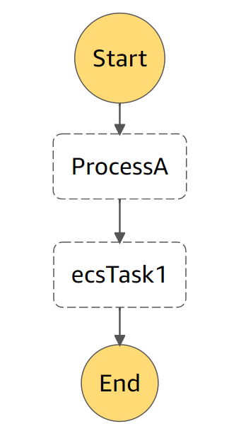

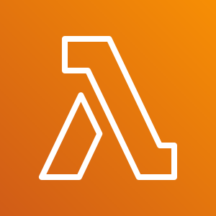
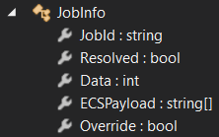
Example 1: Containerized Task Executors
Command.$: $.ECSPayload
Notes:
ProcessA transforms data
ECSTask1 runs Fargate Task
Notes:
Paths

Slide 7
2. Task Token Executor

Slide 8
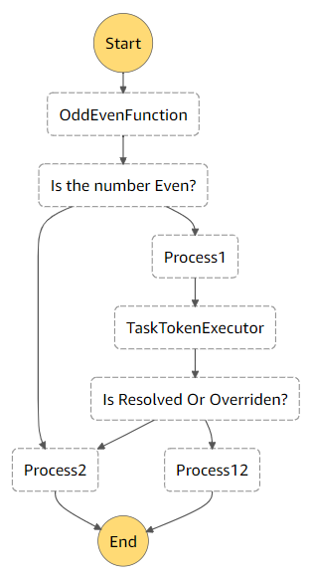
Example 2: Task Token Executor
Initial Input
Task Token Execution:
TaskTokenExecutor Lambda
puts a Json File with request data into s3 Bucket.
Data contains TaskToken
WaitForTaskToken
A Cloud Event Rule
fires at specified time to execute the ECS Fargate Task
This is an independent process out of step function
Fargate Task
generates results and drops response file back to s3
responds back to step function with TaskToken
Process Proceeds

Slide 9
3. Infrastructure as Code
C#/.NetCore 3.1
AWS CDK 1.62.0

Slide 10
AWS Cloud Development Kit(AWS CDK)
Open Source Software Development Framework to model and provision cloud application resources.
Uses familiar programming languages (Python, Java, C#, JavaScript, TypeScript)
.NET Core v3.1 or later
.NET Framework v4.6.1 or later
https://docs.aws.amazon.com/cdk/latest/guide/work-with-cdk-csharp.html
Use of control flow logic (if statements, loops) when defining infrastructure.
Easy Integration and Review.
Code Implementation within IDE.
Produces Cloudformation templates under the hood

Slide 11
AWS Cloud Development Kit(AWS CDK)
Typical CDK Steps
Example
Define Resources
Define S3 Bucket
Define Lambda Function
Define Policies/ Roles/ Permissions
Add Lambda policies and Roles
Assign VPC
Grant Read Write Access
on S3 Bucket to the Lambda Function
Grant Access
Link Resources to Perform a task
Can be Integrating Lambda with Step Function

Slide 12
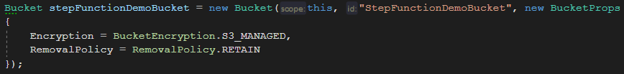
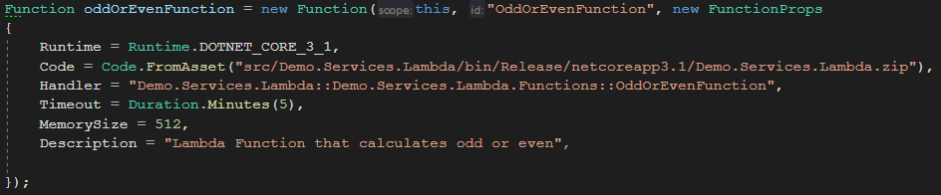

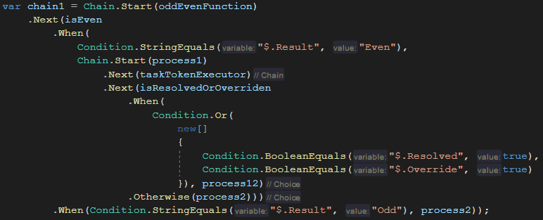
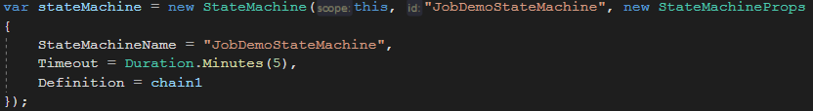
Step Function with CDK
More details in the project…

Slide 13
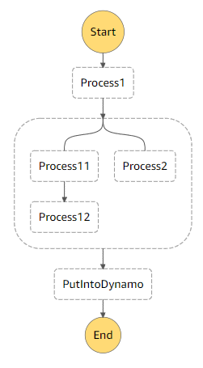
Bonus Example
Parallel Execution
Dynamo Put Item
A→ Input to the Parallel Execution
B→ Result of Process12
C→ Result of Process2
D→ Result of Parallel Execution
[B,C]
“PutIntoDyanmo” step can retrieve Parallel Execution result as
$.D[0] and $.D[1]
A
C
B
D
Keep Exploring !

Slide 14

5. Question and Answer

Slide 15
References
https://aws.amazon.com/step-functions/
https://docs.aws.amazon.com/step-functions/latest/dg/concepts-amazon-states-language.html
https://states-language.net/
https://docs.aws.amazon.com/cdk/index.html
https://docs.aws.amazon.com/cdk/latest/guide/work-with-cdk-csharp.html
https://docs.aws.amazon.com/cdk/api/latest/dotnet/api/Amazon.CDK.AWS.StepFunctions.Tasks.html
https://docs.aws.amazon.com/cdk/api/latest/docs/aws-ecs-readme.html
https://docs.aws.amazon.com/step-functions/latest/dg/connect-to-resource.html#connect-wait-token

